Slide 1
PPP-completeness with Connections to Cryptography
Katerina Sotiraki
MIT
Manolis Zampetakis
MIT
Giorgos Zirdelis
Northeastern U.
LATCA@BiCi
2018

Slide 2
Universal Cryptographic Objects
Assumptions
Natural Universal Objects?
“Explicit constructions that implements P under the sole assumption that P exists.”
Primitives
For instance, universal one-way functions [Levin87], but very “unnatural” and “inefficient”.
Notes:
Kati gia universal objects kai oti ta constructions gia u-OWF den einai natural kai efficient

Slide 3
Universal CRHF
ꓱ CRHF family
H is CRHF
ꓱ A finds collision in h ←H
for all H’ ꓱ A’ finds collision in h’ ← H’
Open problem:
Natural Universal CRHF?

Slide 4
Our result
There exists a natural hash function:
worst-case universal CRHF,
“strong evidence” of average-case hardness.
w-c universal CRHF family H :
ꓱ A finds collision in all h ϵH
ꓱ A’ finds a collision in any compressing function.
Hash function from a generalization of SIS (weak-cSIS)
Notes:
To 2 to xreiazomaste?

Slide 5
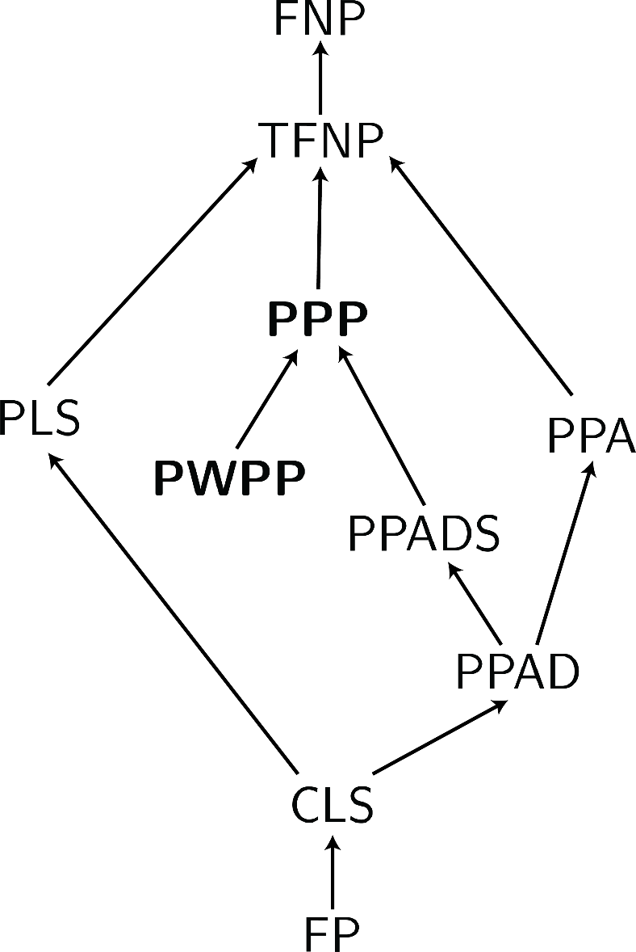
TFNP
FNP: class of search problems whose decision version is in NP.
TFNP: class of total search problems of FNP, i.e. a solution always exist [MP91].
Many applications in game theory, economics, social choice,
(discrete / continuous) optimization, e.g. [JYP88], [BCE+98], [EGG06],
[CDDT09], [DP11], [R15], [R16], [BIQ+17], [GP17], [DTZ18], [FG18] …
Most celebrated result: NASH PPAD-complete [DGP06], [CDT06]
Connections to Cryptography:
[Bur06], [BPR15], [Jer16], [GPS16], [HY17], [RSS17], [HNY17], [KNY17]
Notes:
JYP88: Definition of PLS, Local MAX SAT is PLS-complete, Local MAX-CUT, Local TSP in PLS
BCE+98: Black Box Separation of Classes
EGG06: Market Equilibrium <-
CDDT09: Smoothed Complexity of Lemke – Howson is PPAD-hard
DP11: CLS Definition, Nash Equilibria in Congestion Games, continuous optimization problems.
R15, R16: Approximate Nash Equilibria (Hardness, Fine Grained Complexity) [Best (Student) Paper STOC] [If PPAD is 2^n then n^(log n) approximate Nash in 2-player games]
BIQ+17: PPA hardness of polynomial ideal problem
GP17: Definition PTFNP
DTZ18: Banach is CLS-complete and connections with optimization
FG18: PPA-complete, social choice problem
Bur06: Blum Integers of Factoring in PPA, PPP
BPR15: Obfuscation
Jer16: Factoring in PPA, PPP
GPS16: OWF -> OWP etc…
HY17: Obfuscation in CLS
RSS17: Black Box Separation of PPAD-hardness with OWF
HNY17: If there exists a hard on average problem in NP then TFNP is hard on average
KNY17: Ramsey and Multi-collision Resistance

Slide 6
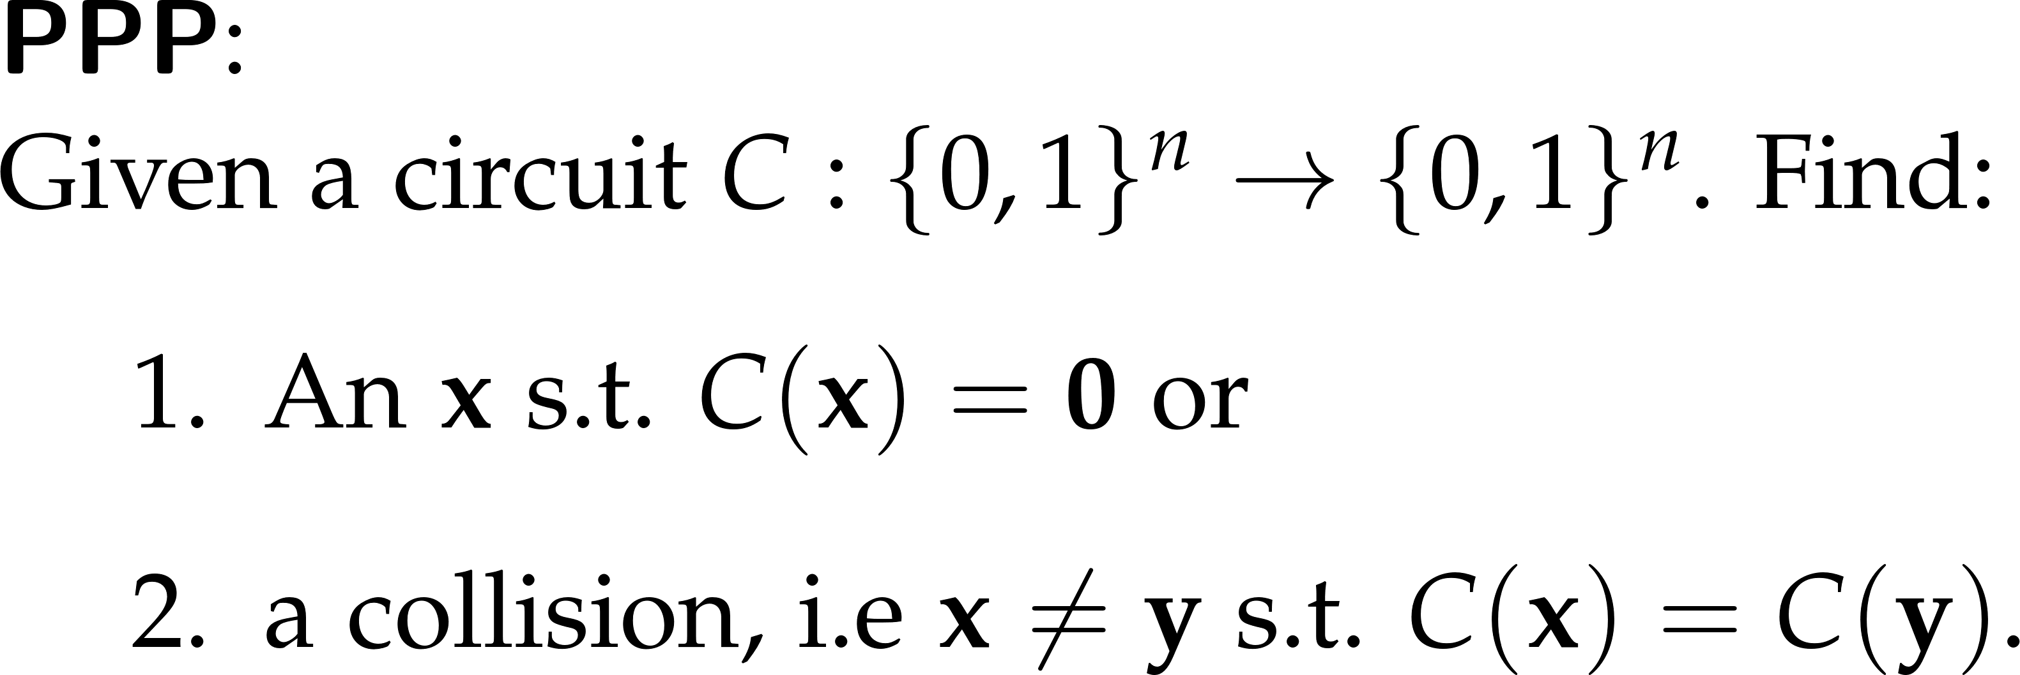
PPP and PWPP
“Total search problems should be classified in terms of the profound mathematical principles that are invoked to establish their totality.”
Papadimitriou ‘94
PPP, PWPP
Pigeonhole principle

Slide 7
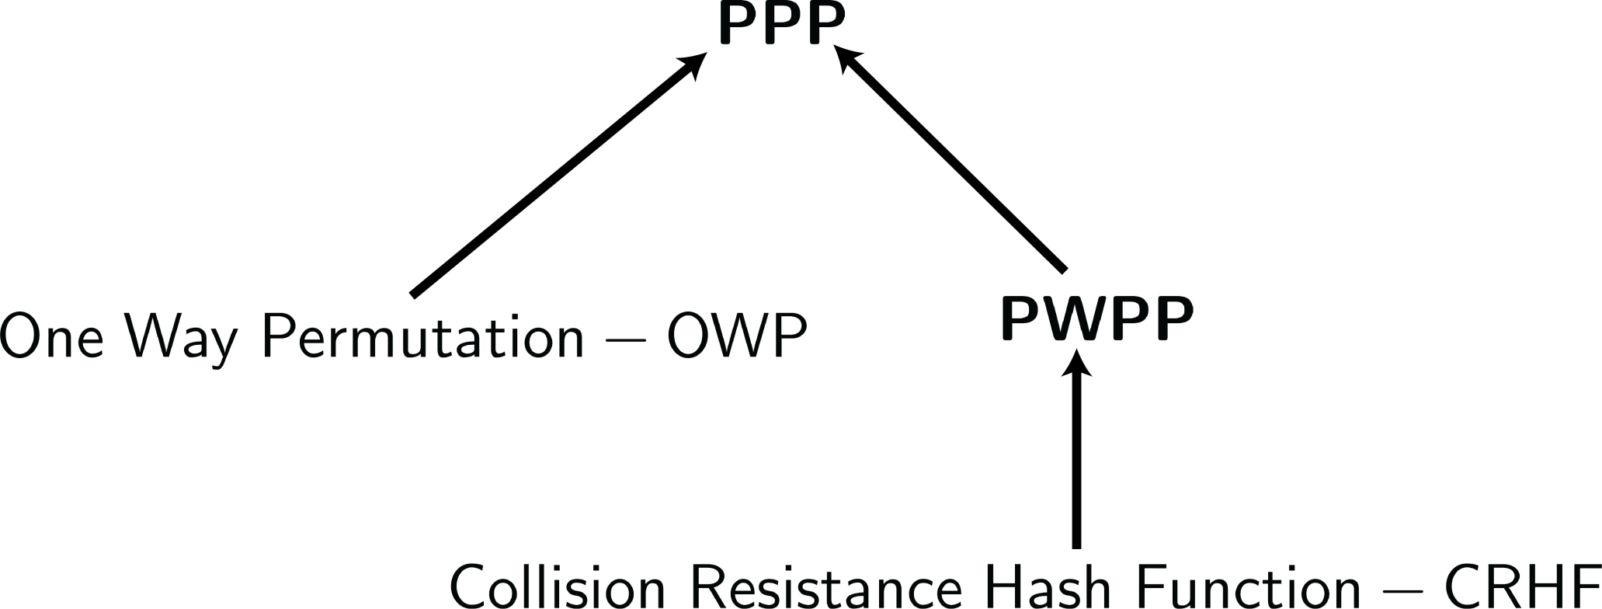
PPP/PWPP and Cryptography

Slide 8
PPP/PWPP-completeness
A longstanding open problem since [Pap94].
Our contribution:
We identify the first PPP/PWPP-complete problems.
This talk: PWPP.
A PWPP-complete problem defines a w-c universal CRHF.
Main Theorem:
weak-cSIS is PWPP-complete.

Slide 9
Short Integer Solution Problem

Slide 10
Short Integer Solution Problem
Hash function family:
Key:
Hash:
A
If SIS is hard on average, then H is collision-resistant.

Slide 11
“CRHF”-completeness
Ideal world: family H as hard as NP-complete problem.
Real world: family H as hard as a problem in NP$∩$ coNP .
Idea:
Define a complexity class that contains all CRHF
and identify a complete problem.
Notes:
JYP88: Definition of PLS, Local MAX SAT is PLS-complete, Local MAX-CUT, Local TSP in PLS
BCE+98: Black Box Separation of Classes
EGG06: Market Equilibrium <-
CDDT09: Smoothed Complexity of Lemke – Howson is PPAD-hard
DP11: CLS Definition, Nash Equilibria in Congestion Games, continuous optimization problems.
R15, R16: Approximate Nash Equilibria (Hardness, Fine Grained Complexity) [Best (Student) Paper STOC] [If PPAD is 2^n then n^(log n) approximate Nash in 2-player games]
BIQ+17: PPA hardness of polynomial ideal problem
GP17: Definition PTFNP
DTZ18: Banach is CLS-complete and connections with optimization
FG18: PPA-complete, social choice problem
Bur06: Blum Integers of Factoring in PPA, PPP
BPR15: Obfuscation
Jer16: Factoring in PPA, PPP
GPS16: OWF -> OWP etc…
HY17: Obfuscation in CLS
RSS17: Black Box Separation of PPAD-hardness with OWF
HNY17: If there exists a hard on average problem in NP then TFNP is hard on average
KNY17: Ramsey and Multi-collision Resistance
11

Slide 12
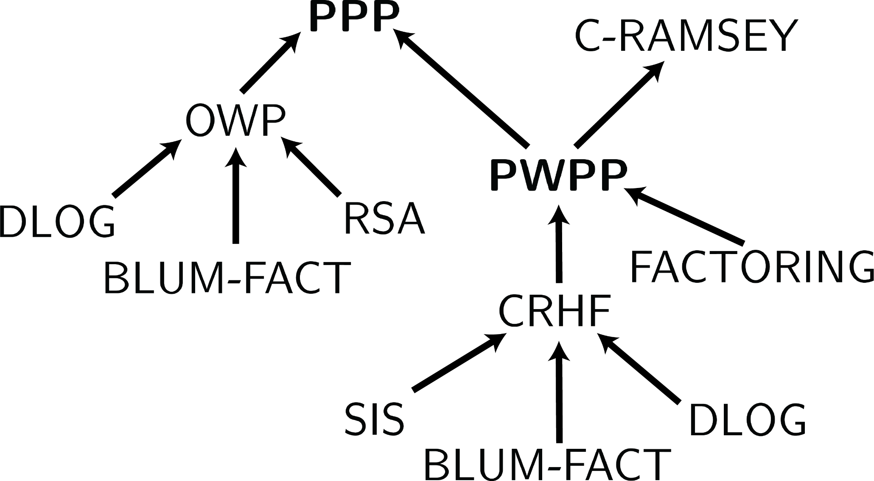
PPP/PWPP and Cryptography

Slide 13
PPP/PWPP and Cryptography
[KNY17]
[Jer16]

Slide 14
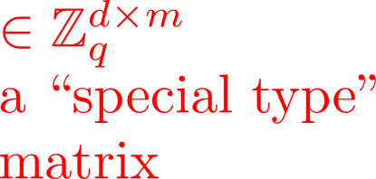
weak-cSIS Problem

Slide 15
weak-cSIS is PWPP-hard
weak-cSIS:
Input: matrices A and G
Output: vectors x and y
PWPP:
Input: circuit C
Output: vectors x and y
Some of the main ideas:
- There exists a linear modular equation for NAND gates.
- For any circuit C:
Use G to constrain x to encode C’s evaluation gate by gate.
Ax = C(x_{input}).
Notes:
- Extra ideas to make sure that m > log(q)(r + d).
15

Slide 16
Binary invertible matrix
Notes:
16

Slide 17
weak-cSIS ϵ PWPP
Notes:
Den einai akrivos sosto auto giati kapos theloume na poume oti apo kapoia coordinates tou x mporo na vro ta ypoloipa.
17

Slide 18
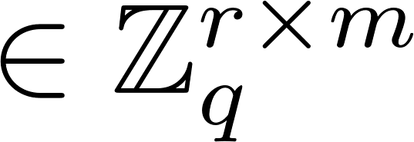
Hash function
Hash function family:
Key:
Hash(x):
A

Slide 19
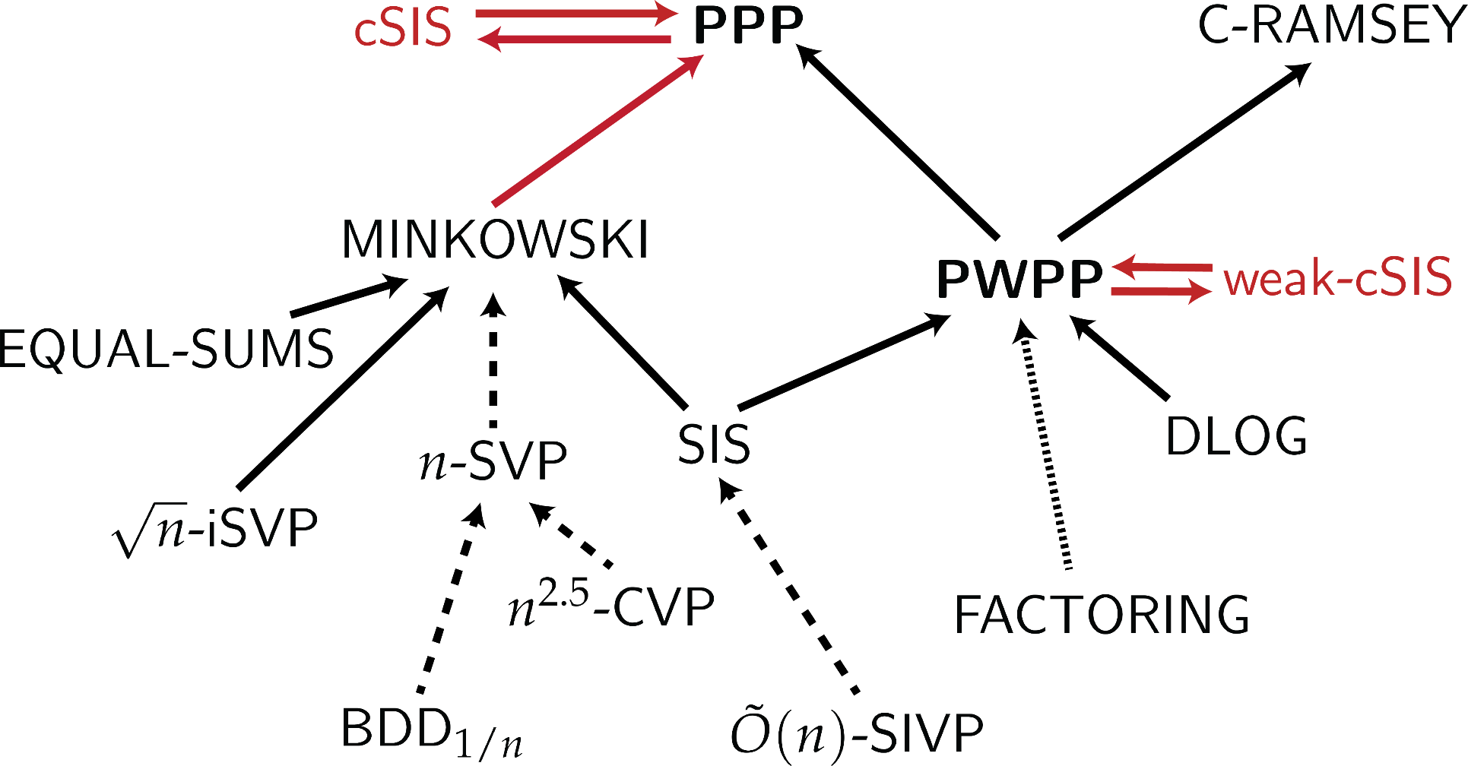
Lattices and PPP
[KNY17]
[BJPPR15]
Notes:
19

Slide 20
Open Problems
worst-to-average case reduction for weak-cSIS?
universal CRHF based on weak-cSIS
MINKOWSKI
PPP
SIS
PWPP
?
?
Notes:
20

Slide 21
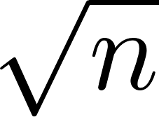
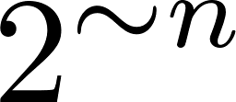
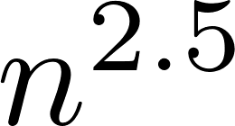
Open Problems
(Gap)SVP
NP-complete
NP $∩$coNP
PPP
P
PPP-hard/complete?
(Gap)CVP
NP-complete
NP $∩$coNP
PPP
P
PPP-hard/complete?
PPP?
Thank you!
Notes:
21

Slide 22
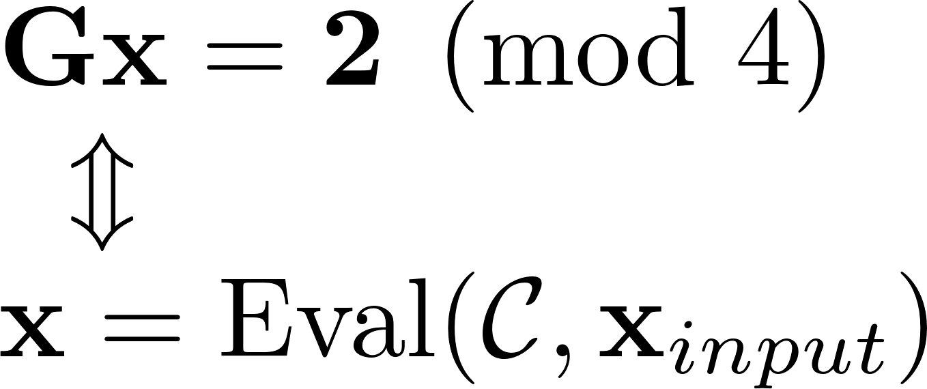
weak-cSIS is PWPP-hard (sketch)
q = 4
Notes:
22

Slide 23
weak-cSIS is PWPP-hard (sketch)
q = 4
Notes:
23

Slide 24
weak-cSIS is PWPP-hard (sketch)
q = 4
It needs more work to make it homogenous…
Notes:
24

